Slide 1

Minor Project Presentation on Cars Dealing Website McQueen
Core branch:
Artificial Intelligence & Data Science (I1)
J Monesh – 160121771039
Md Mushtaq – 160121771050 G Sai Aashrith Reddy – 160121771058
Mentor: Smt. V. Krishna Aravinda Designation: Assistant Professor

Slide 2

Contents
Motivation
Problem Statement
Introduction
Existing System
Proposed System
Disadvantages of Proposed System
Advantages of Proposed System
UML Diagram
System Architecture
Results
Future Scope
Conclusion

Slide 3
Motivation
The motivation behind developing this project stems from the recognition of the evolving landscape within the automotive industry and the desire to address existing challenges faced by both buyers and sellers in the current online marketplace ecosystem. The overarching goal is to redefine and enhance the vehicle buying and selling experience by leveraging technology and incorporating user-centric features.
The development of a simplistic user interface and personalized search tools is geared towards optimizing the overall user experience. By making the buying and selling process easy and intuitive, the platform aims to attract a broader audience and ensure user satisfaction.

Slide 4
Introduction
Car Dealing websites are websites that enable interested buyers to buy cars and car owners or dealers to sell cars at reasonable prices, online. With the trust and convenience that they offer, they have, in a way, changed or transformed the automotive industry.
The data which is displayed about the cars is real-time data and is regularly updated as we are using APIs from RapidAPI for fetching car details.
For buyers, we provide a vast inventory of pre-owned and new vehicles, comprehensive vehicle histories, and personalized search tools, ensuring they easily find their dream car.
For sellers, we offer a user-friendly listing process, expert pricing guidance, and a broad audience reach, resulting in quicker sales at the best prices. Moreover, we intend to prioritize safety, security, and secure payment options.

Slide 5
Problem Statement
In today's dynamic automotive market, there is a need for a comprehensive and user-friendly online platform that facilitates the buying and selling of cars. Traditional methods of buying and selling cars often involve time-consuming processes, lack transparency, and may not provide users with a wide range of choices. Additionally, the absence of a centralized and efficient online marketplace contributes to a fragmented experience for both buyers and sellers.

Slide 6
Existing System
Websites like autocarindia.com and cars24.com have played a transformative role in the automotive industry by introducing online platforms that facilitate the buying and selling of vehicles.
These platforms have gained prominence due to the convenience they provide to users, enabling them to navigate the vehicle trading process with ease. Additionally, the platforms have established trust through their online presence and services.
While these platforms provide a streamlined and efficient way to buy or sell vehicles, users must weigh the convenience offered against the potential trade-off in terms of lower selling prices and the additional fees incurred during the transaction process.

Slide 7
Proposed System
McQueen prioritizes a seamless experience for buyers and sellers by leveraging technology. The platform features a user-friendly interface and robust search tools, simplifying the process of finding, comparing, and purchasing both new and used vehicles.
The platform focuses on transparency, providing detailed vehicle information to build trust between buyers and sellers. This approach benefits buyers by offering insights into their chosen vehicles and allows sellers to effectively showcase their offerings, fostering confidence in the transaction process.
A key differentiator is McQueen's commitment to offering guidance, data analytics, and transparent pricing without charging any service fees. Unlike some existing platforms, this approach enhances cost-efficiency for both buyers and sellers, making transactions more attractive without the burden of additional costs.

Slide 8
Disadvantages of Proposed System
Limited Market Presence: As a new entrant, the platform may face challenges in gaining market visibility and attracting a significant user base, especially if potential users are already accustomed to existing, well-established platforms.
Seller Adoption: Sellers might be hesitant to adopt a new platform, particularly if they have established relationships with existing marketplace websites. Convincing sellers to list their vehicles on the proposed platform could be a challenge, affecting the diversity and size of the vehicle inventory.
Potential Pricing Challenges: While the intention is to provide fair and transparent pricing, accurately determining the value of a used vehicle is inherently complex. The platform's pricing guidance and data analytics may not always align with sellers' expectations, leading to disputes or dissatisfaction.

Slide 9
Advantages of Proposed System
Seamless User Experience: The platform prioritizes a seamless and user-friendly interface, making it easy for buyers to find, compare, and purchase vehicles. This enhances overall user satisfaction and encourages user retention.
Comprehensive Vehicle Information: Buyers benefit from detailed and real-time information about the vehicles, including histories and condition reports. This transparency builds trust and confidence, leading to more informed purchasing decisions.
Elimination of Service Fees: A significant advantage is the absence of service fees. Unlike some existing platforms, McQueen's system allows users to transact without incurring additional costs, promoting cost efficiency for both buyers and sellers.
Transparent Pricing Model: The platform's commitment to fair and transparent pricing fosters trust between buyers and sellers. Clear and open pricing guidance enhances the credibility of the platform, creating a positive and trustworthy marketplace.

Slide 10


UML Diagram
Open Website
Explore cars
Buy/Sell cars
SignUp/Login
User
Server
Checkout

Slide 11
System Architecture
Open Website
Login/Signup
View Cars
Dashboard
View Detailed specifications of car
Dashboard
Profile
Transactions
Login/Signup
Logout
Enter Car Details and place order for sale
Enter Purchase details and place order
Landing Page

Slide 12
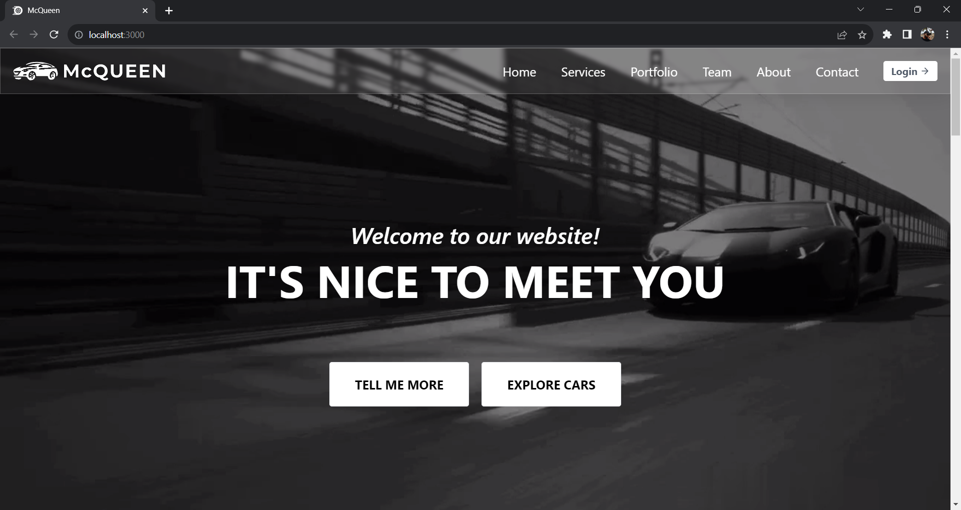
Result & Discussion
This is an User Interface of our Project

Slide 13
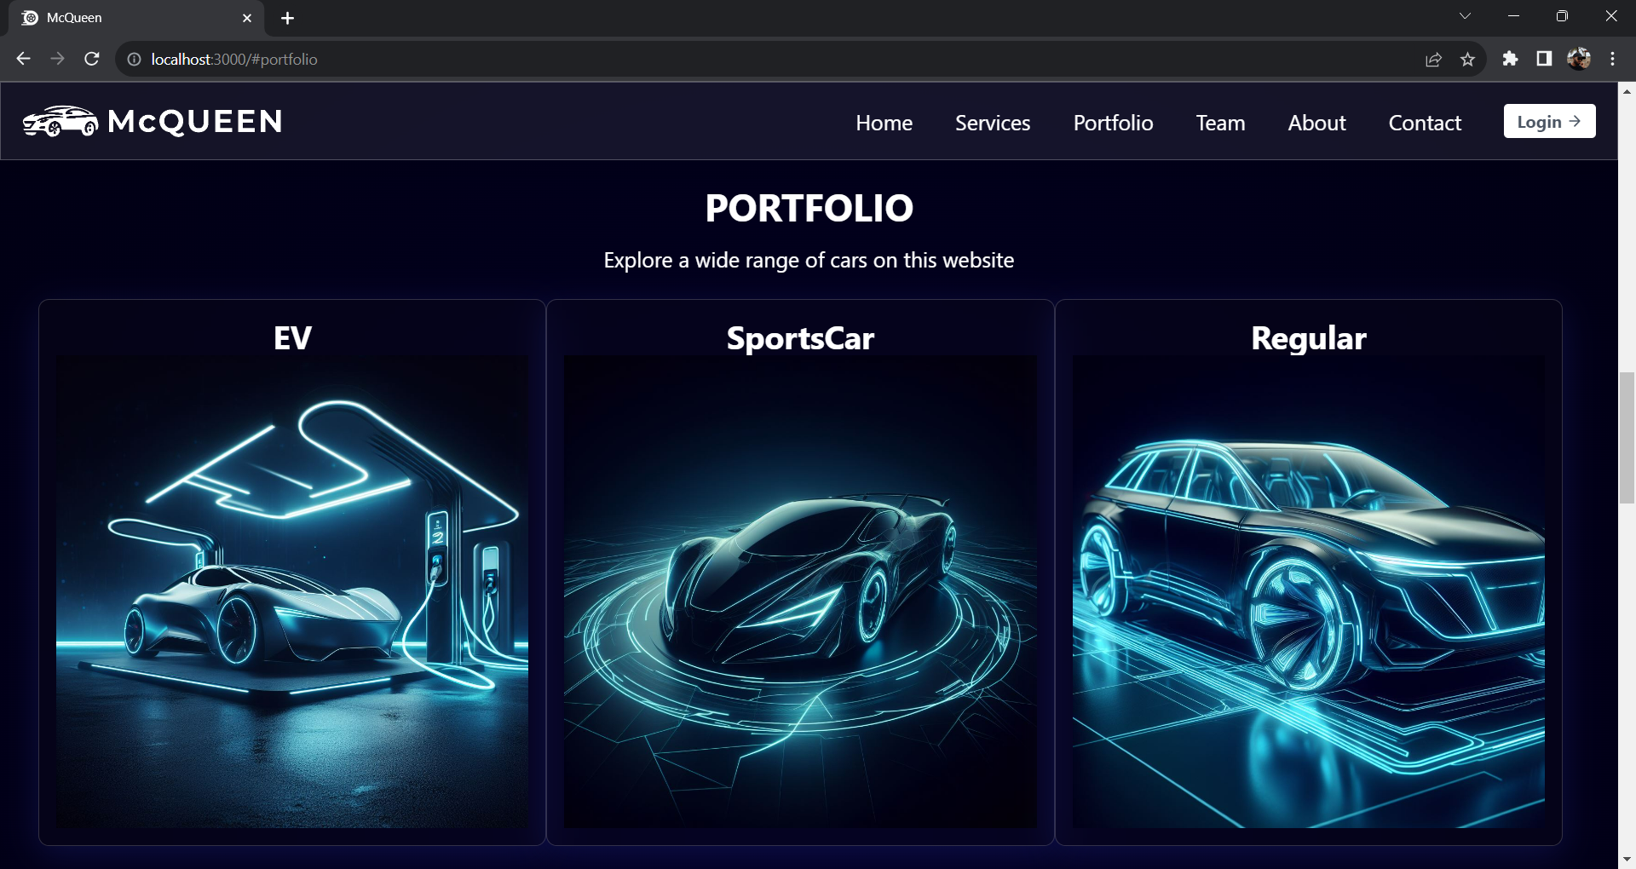
Result & Discussion
This is an User Interface of our Project

Slide 14
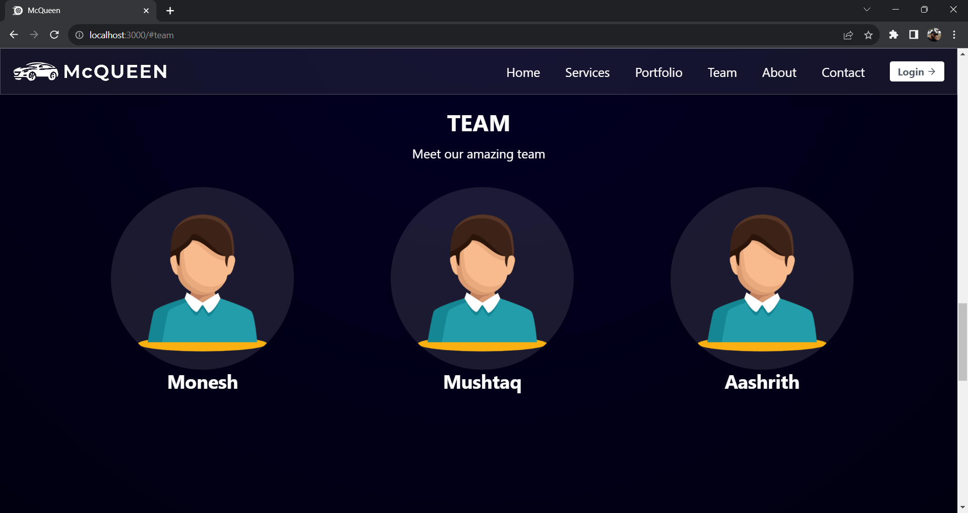
Result & Discussion
This is an User Interface of our Project

Slide 15
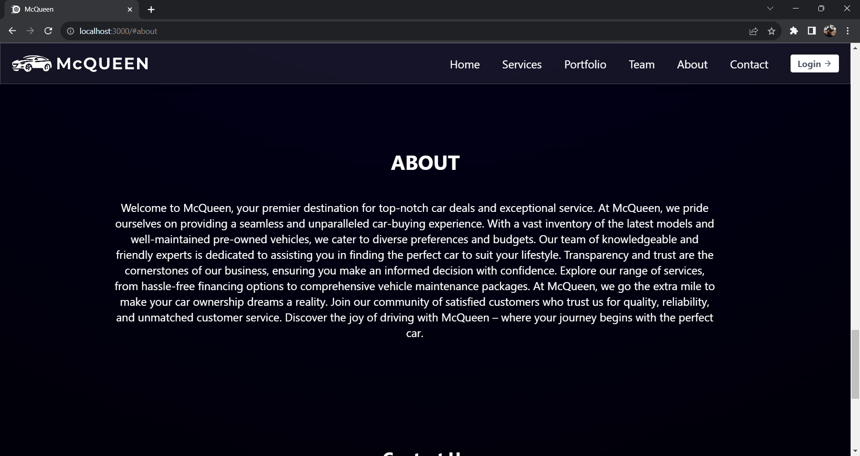
Result & Discussion
This is an User Interface of our Project

Slide 16
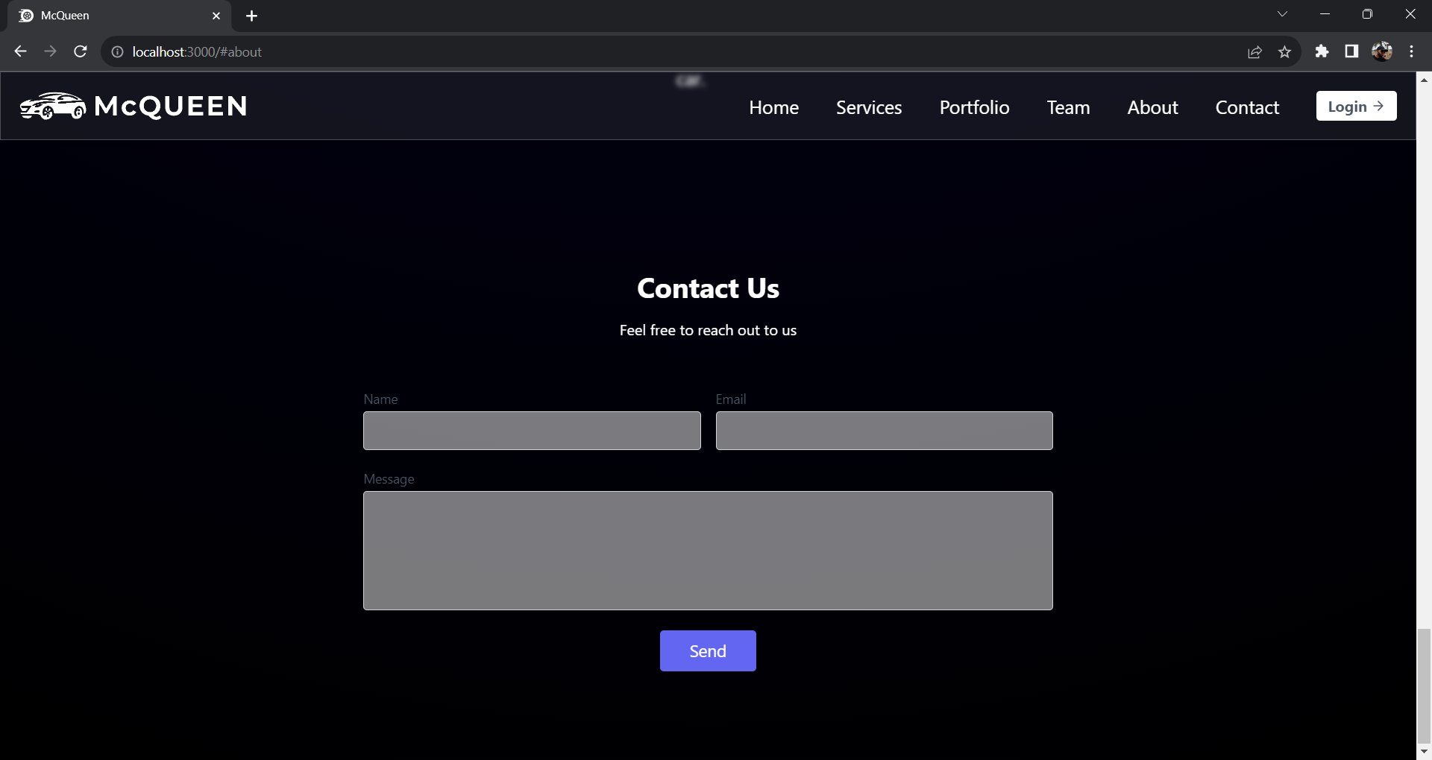
Result & Discussion
This is an User Interface of our Project

Slide 17
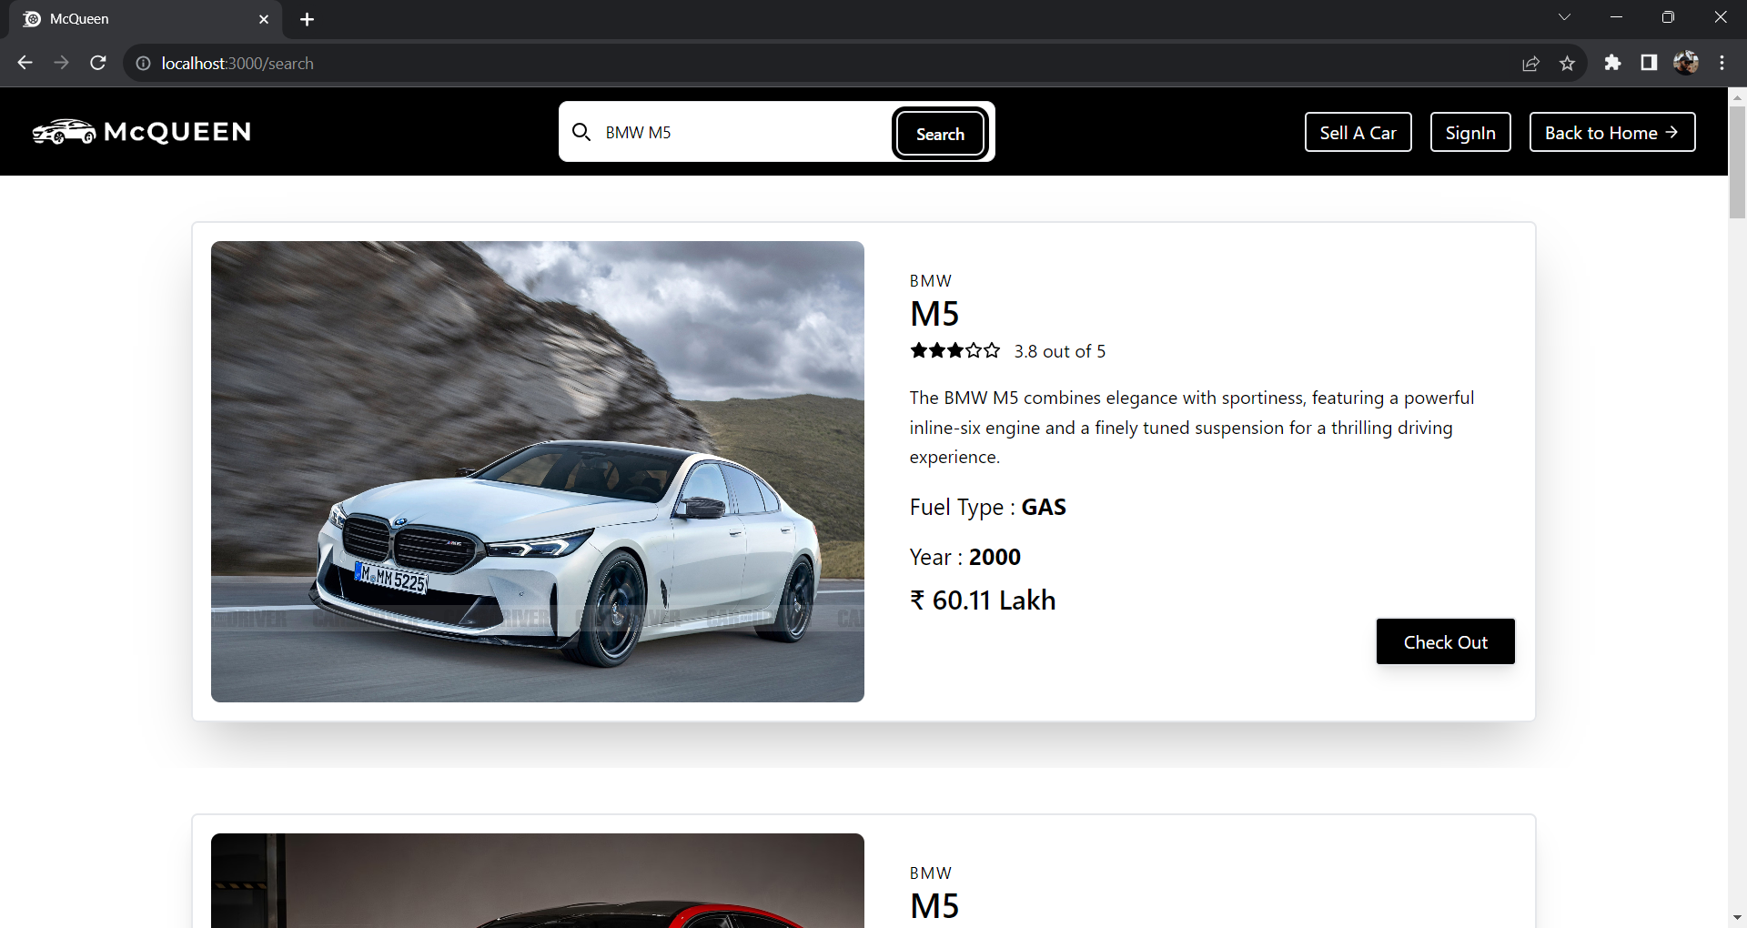
Result & Discussion
This is an User Interface of our Project

Slide 18
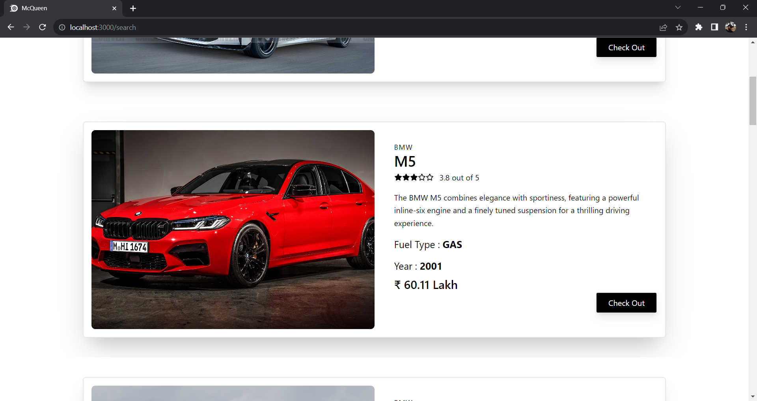
Result & Discussion
This is an User Interface of our Project

Slide 19
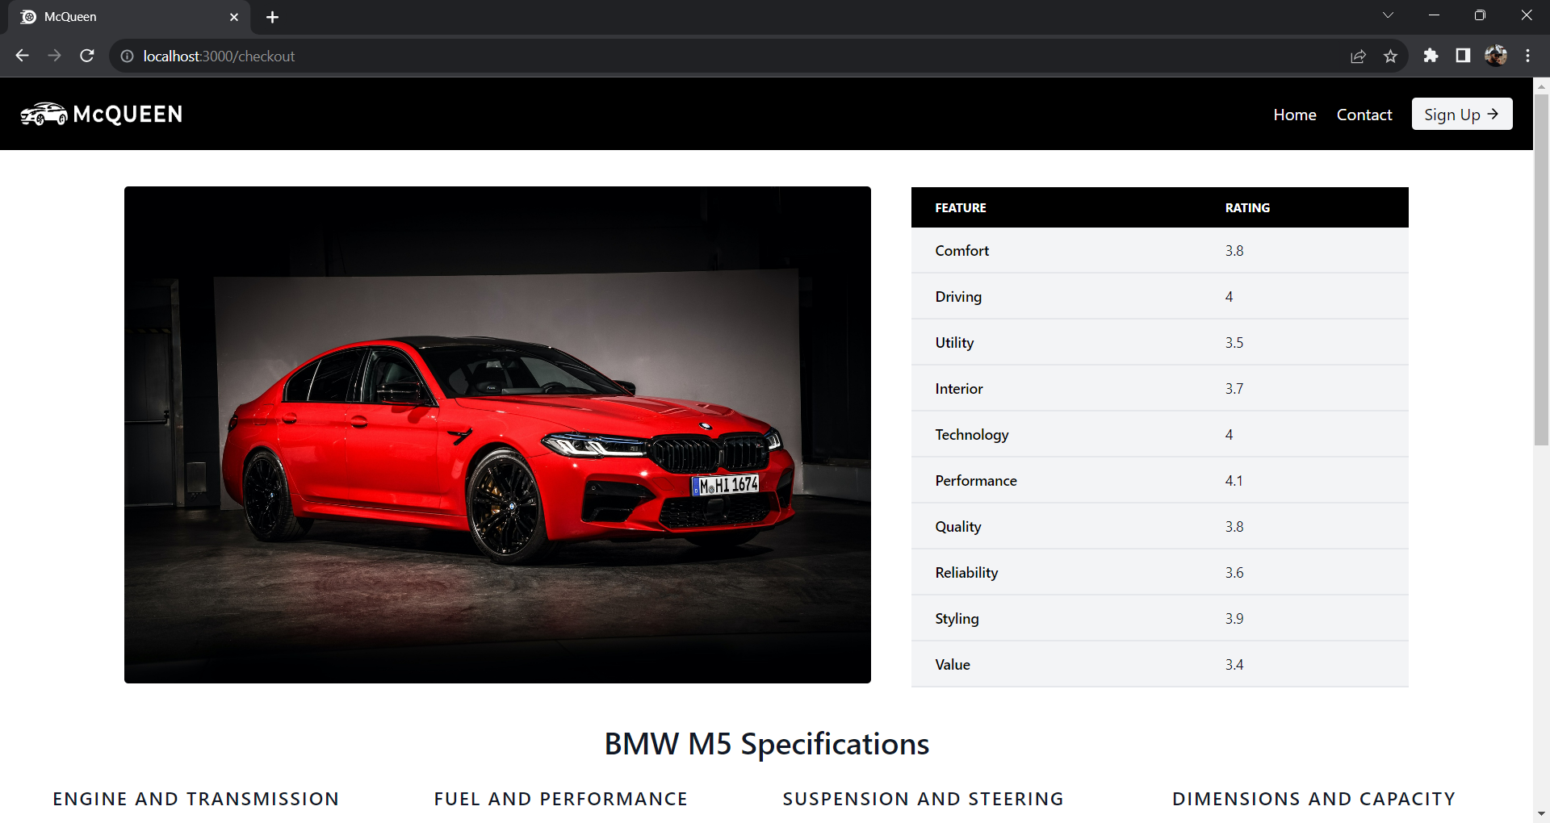
Result & Discussion
This is an User Interface of our Project

Slide 20
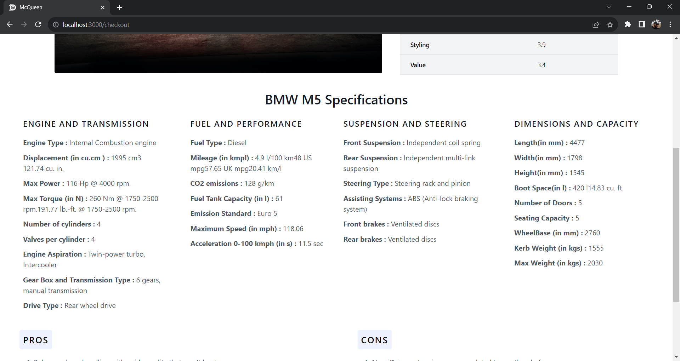
Result & Discussion
This is an User Interface of our Project

Slide 21
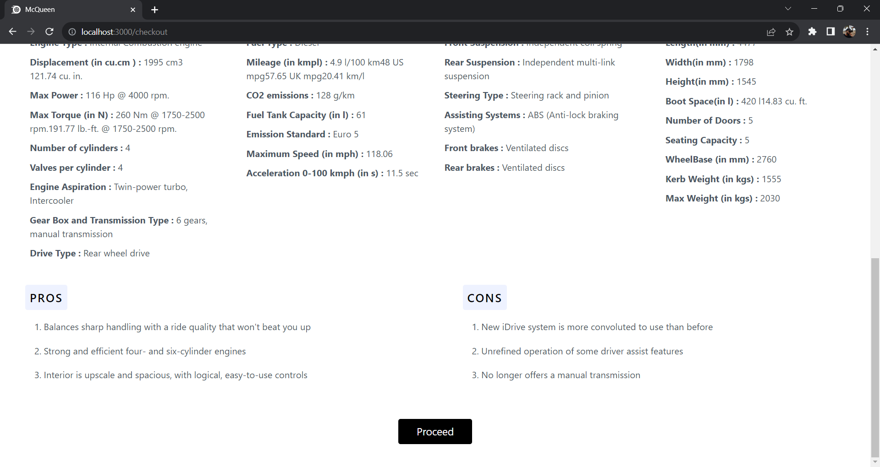
Result & Discussion
This is an User Interface of our Project

Slide 22
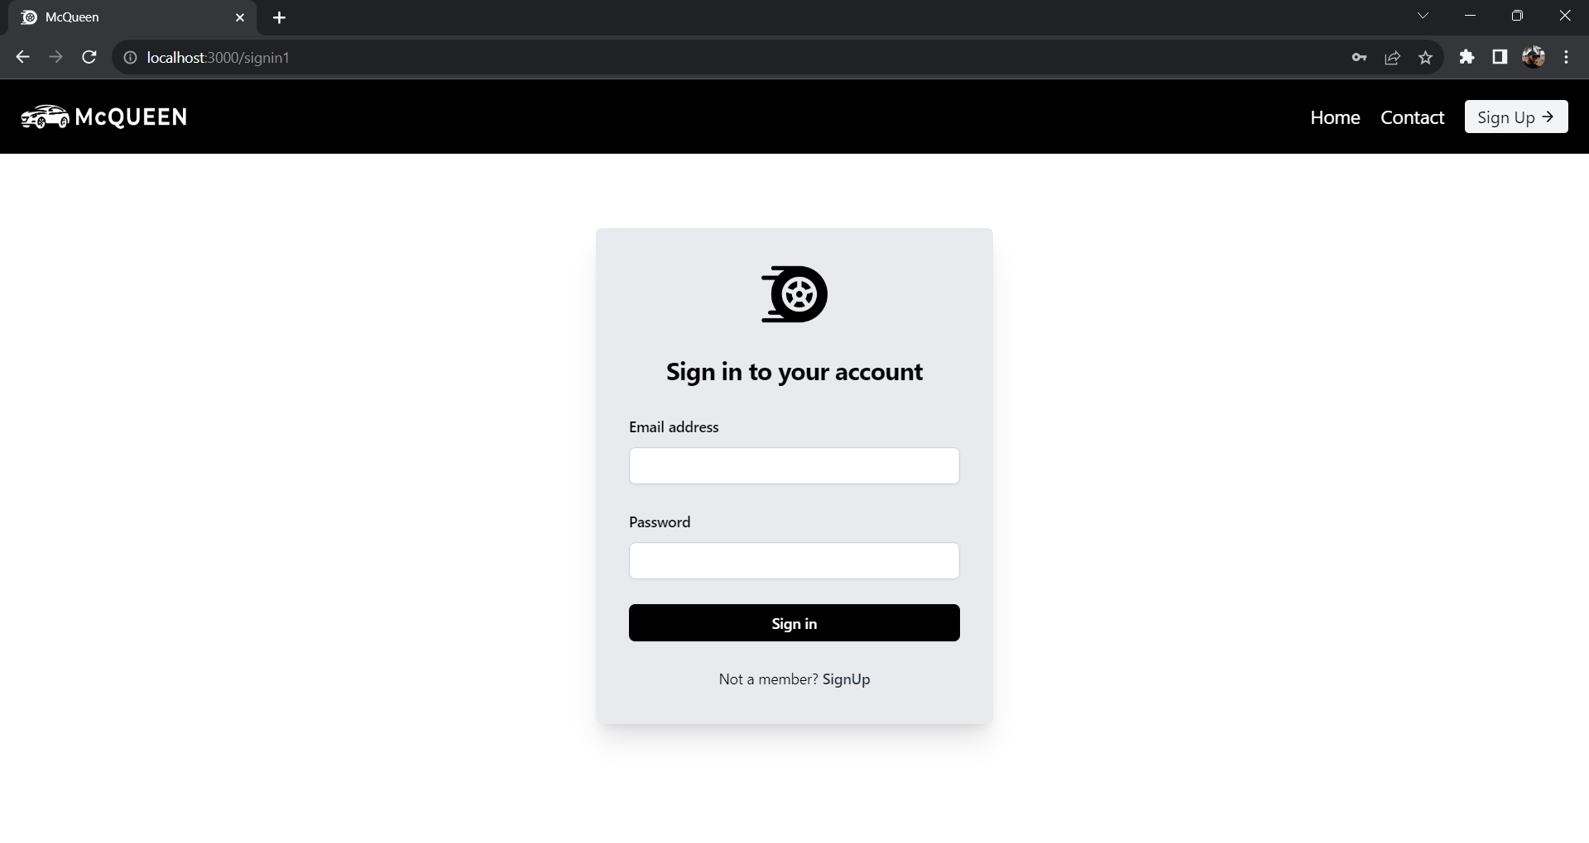
Result & Discussion
This is an User Interface of our Project

Slide 23
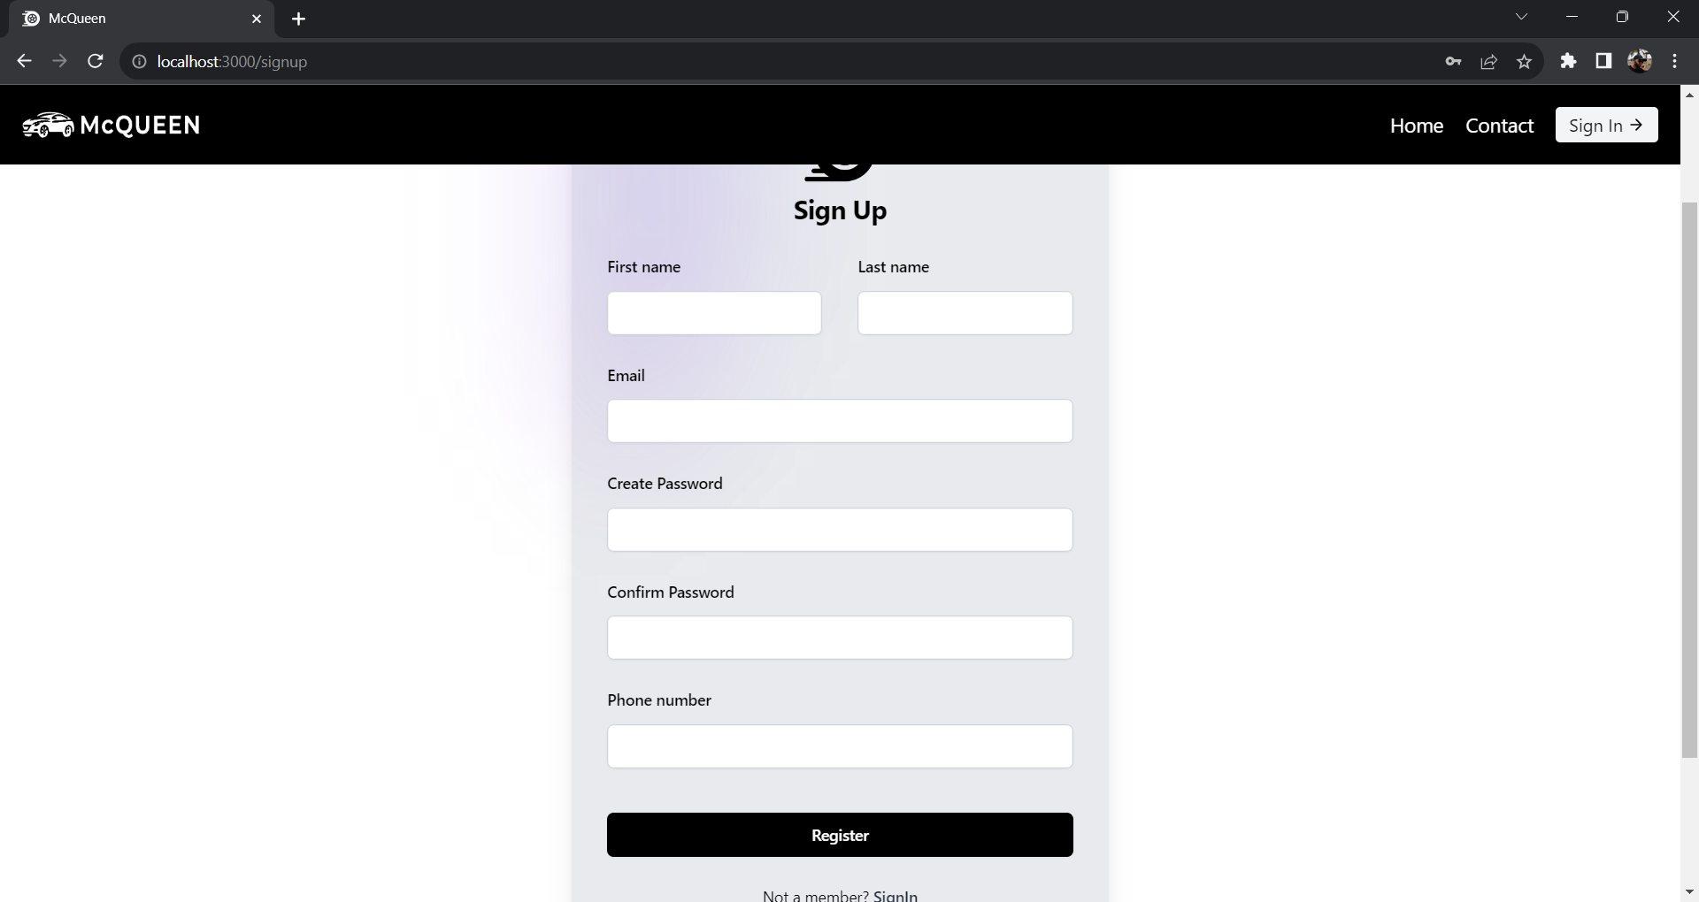
Result & Discussion
This is an User Interface of our Project

Slide 24
Result & Discussion
This is an User Interface of our Project

Slide 25
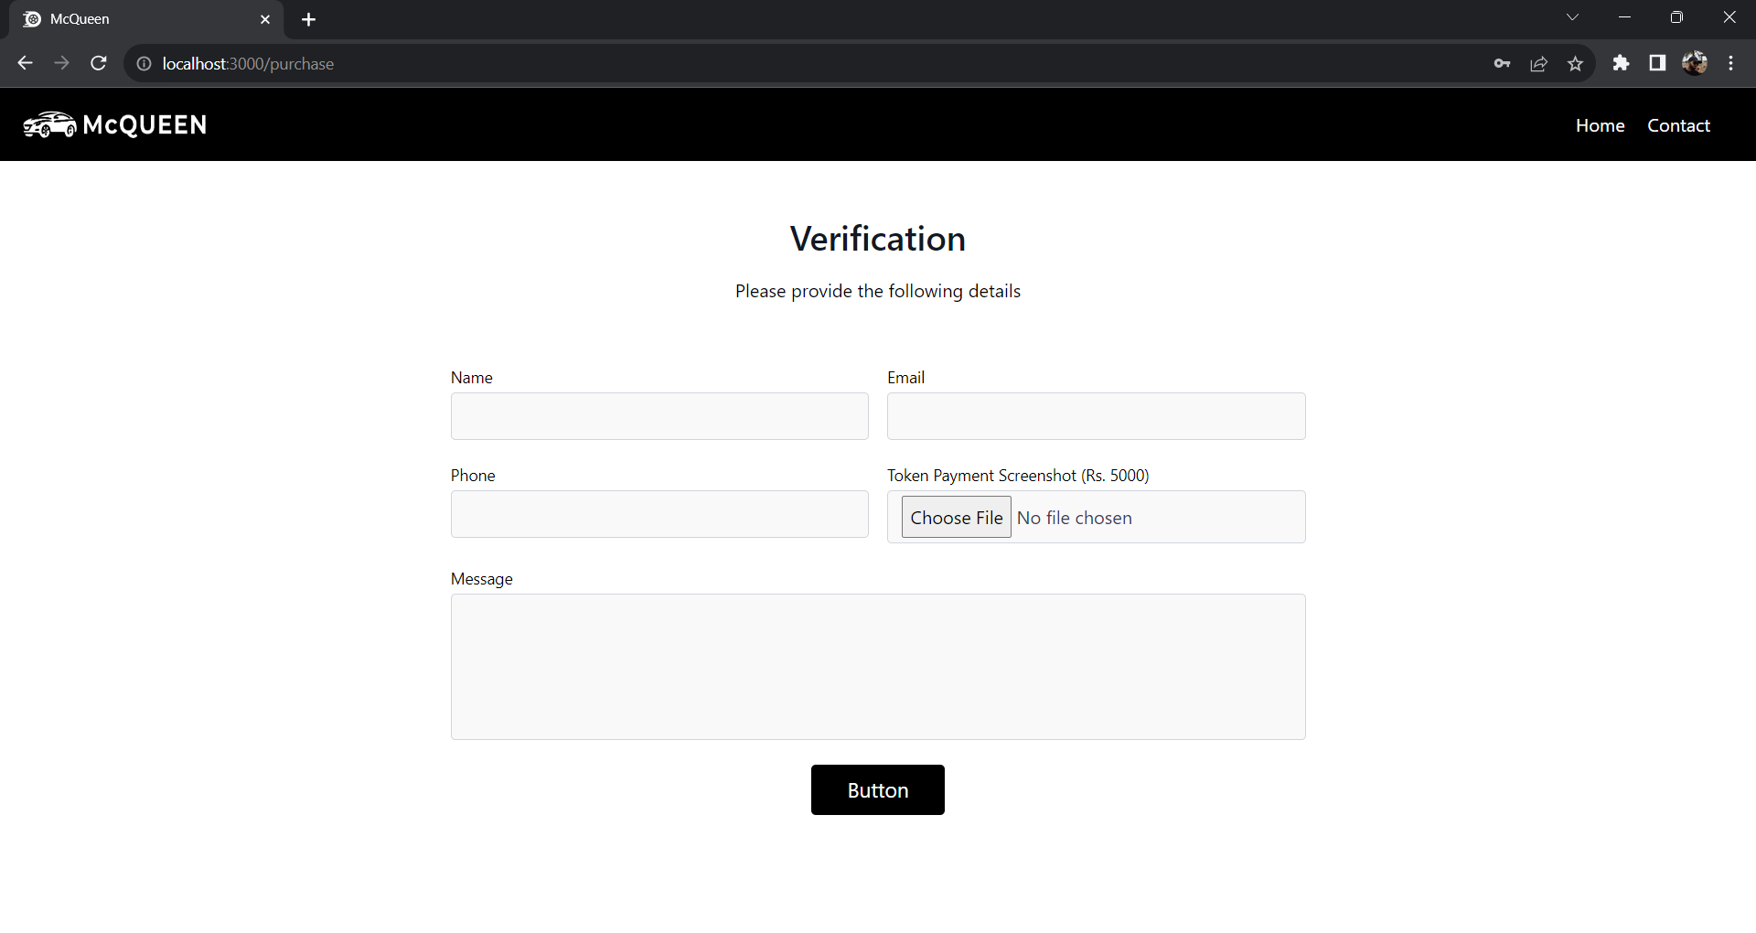
Result & Discussion
This is an User Interface of our Project

Slide 26
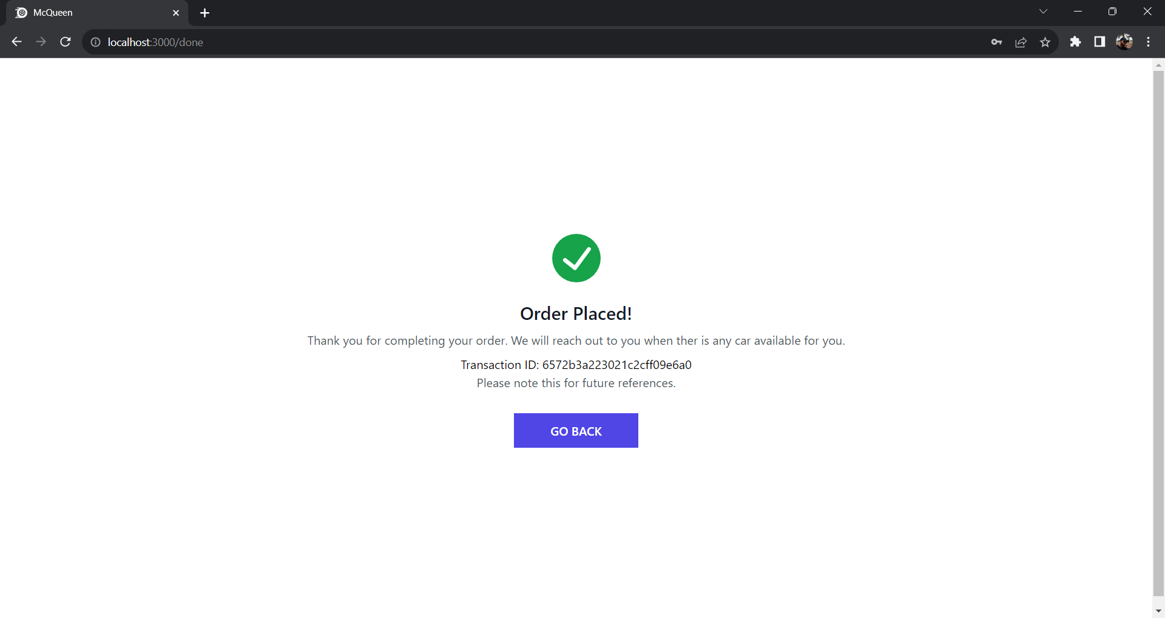
Result & Discussion
This is an User Interface of our Project

Slide 27
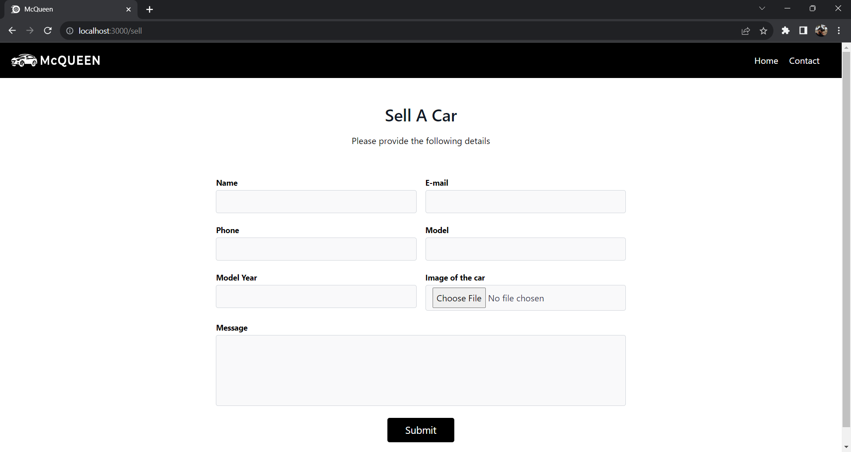
Result & Discussion
This is an User Interface of our Project

Slide 28
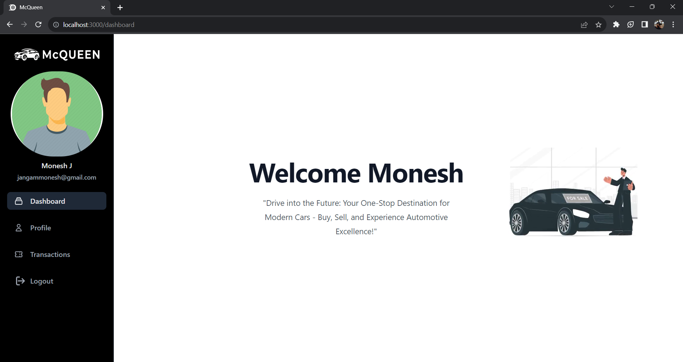
Result & Discussion
This is an User Interface of our Project

Slide 29
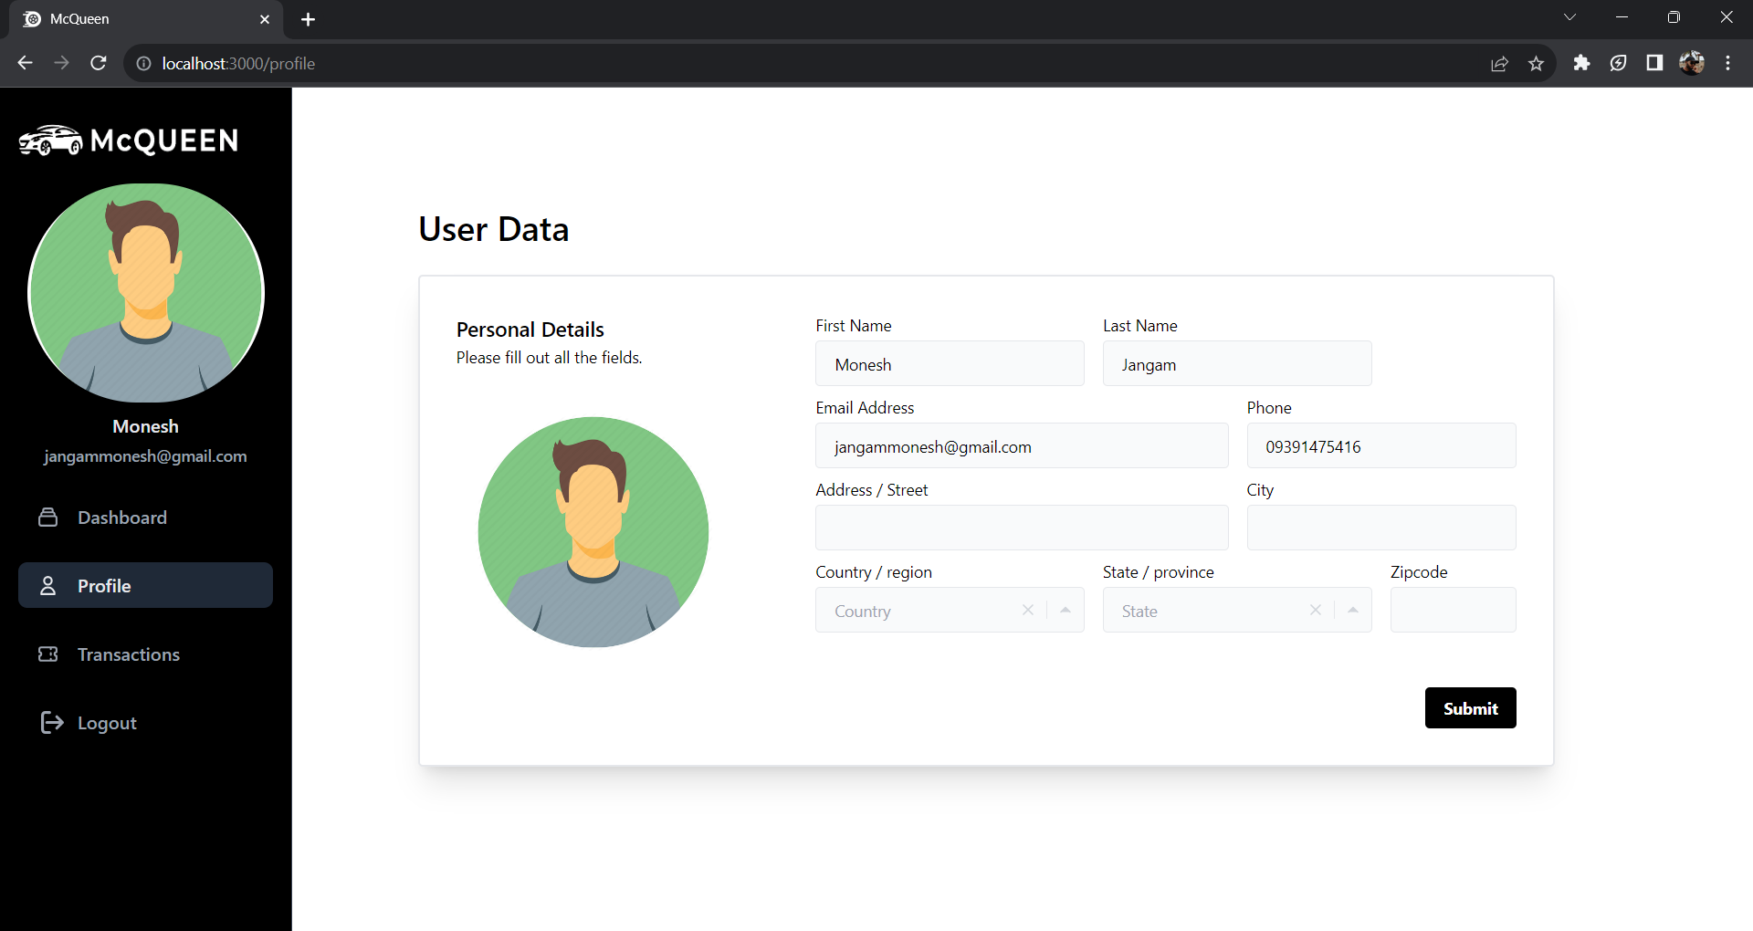
Result & Discussion
This is an User Interface of our Project

Slide 30
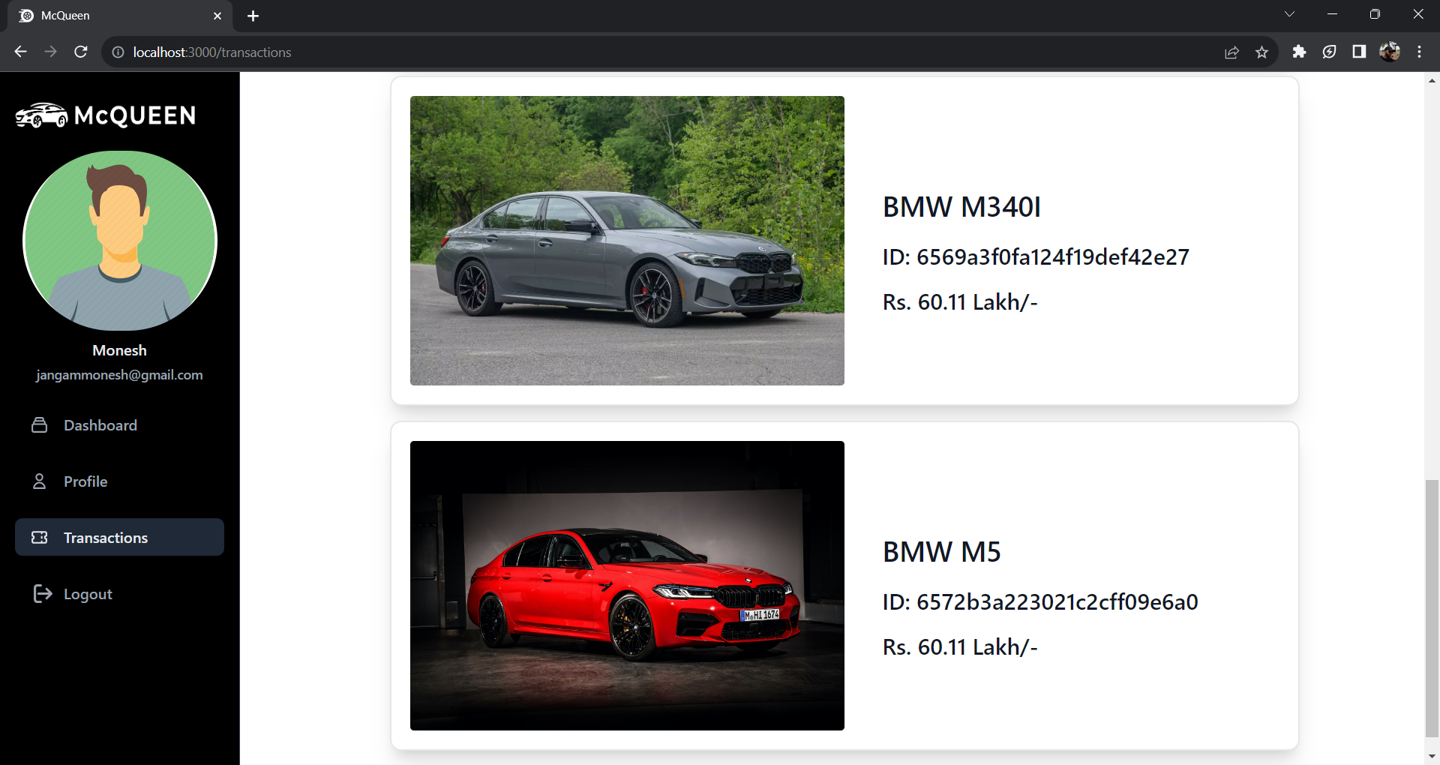
Result & Discussion
This is an User Interface of our Project

Slide 31
Future Scope
Expansion of Services
Mobile Application Development
Blockchain Integration for Security
Enhanced Personalization
Enhanced User Engagement Features
Data Security and Privacy Measures

Slide 32
Conclusion
In conclusion, the envisioned online automotive marketplace, aptly named McQueen, represents a forward-thinking solution that seeks to redefine the vehicle trading experience. By seamlessly integrating cutting-edge technologies and prioritizing user-centric features, McQueen addresses existing challenges in the automotive marketplace.
The commitment to transparency, security, and fair pricing sets this platform apart, offering a superior alternative to conventional online marketplaces. As we embark on this journey, the future holds exciting possibilities for expansion, integration of advanced technologies, and continuous improvement.
McQueen aspires to not only simplify the buying and selling process but also foster a community of trust, innovation, and sustainability within the automotive industry.

Slide 33
Thank You

Slide 34
Any Queries?....

